Slide 1
Coplanar Waveguide Resonators for Circuit Quantum Electrodynamics: Summary
David Shem-Tov
Sep 2025

Slide 2
Motivation
CPWs can easily be designed to operate at frequencies up to 10 GHz or higher
Quality factors ranging from a few hundreds to a several hundred thousands
  Low Q is good for fast measurement of the qubit state
  High Q is good for quantum memory applications
Other applications:
  Single Photon Detector
  Parametric amplifier

Slide 3
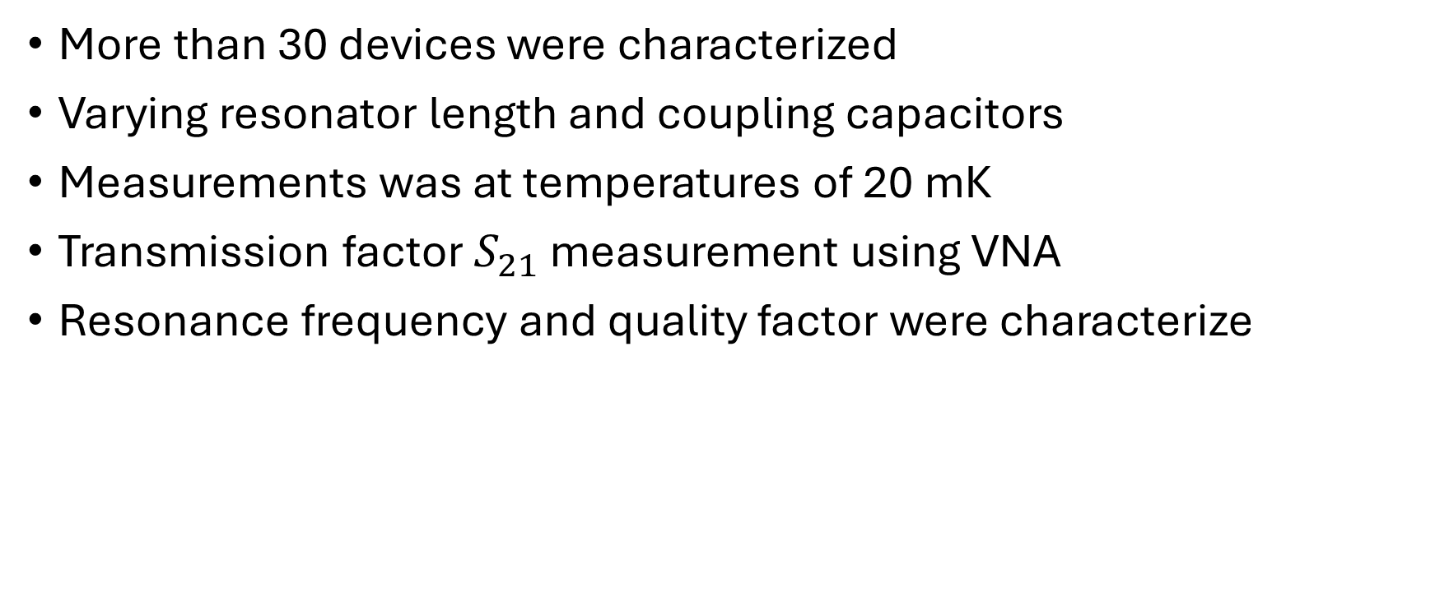
Overview
More than 30 devices were characterized
Varying resonator length and coupling capacitors
Measurements was at temperatures of 20 mK
Transmission factor $S_{21}$ measurement using VNA
Resonance frequency and quality factor were characterize

Slide 4
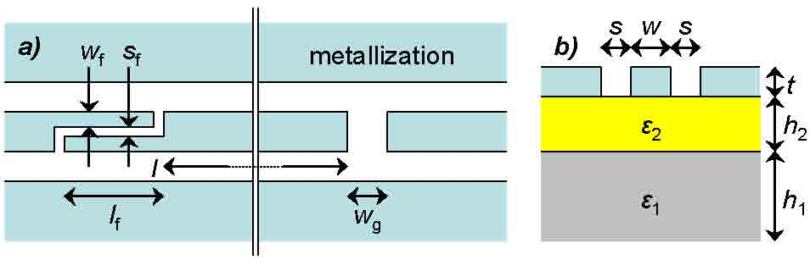
Device Geometry
Resonator length l between 8 and 29 mm
Coupled with capacitors in both ends:
  finger capacitors (1-8 fingers)
  a gap capacitor with gap from 10 to 50 μm
Fabricated on high resistivity, undoped silicon substrate
  ε₁ – non-oxide part, around 500 μm thick
  ε₂ – oxide part, around 550 nm thick
Notes:
w_{f} = 3.3 µm, s_{f} = 3.3 µm, l_{f} = 100 µm
w = 10 µm, s = 6.6 µm
ε₁ = 11.6, ε₂ = 3.78

Slide 5
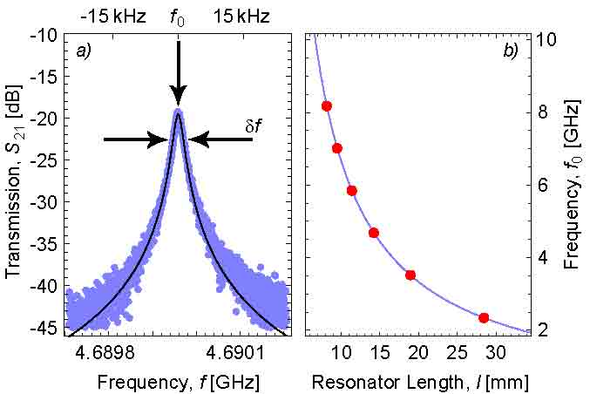
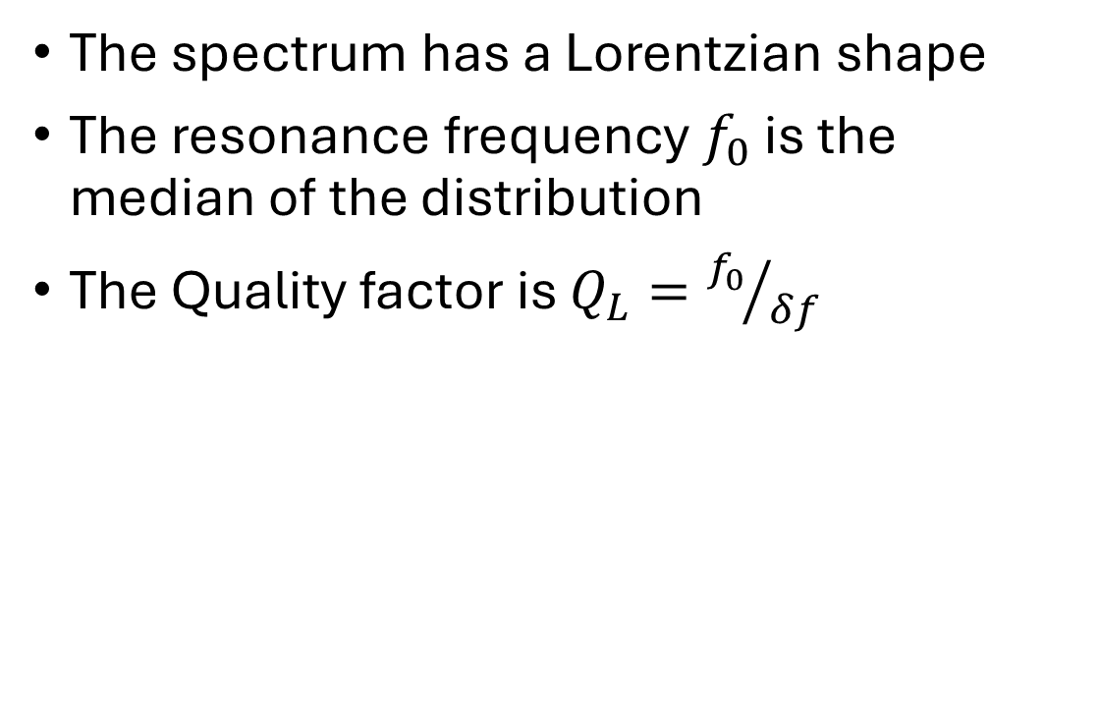
Transition measurements and properties
The spectrum has a Lorentzian shape
The resonance frequency $f_{0}$ is the median of the distribution
The Quality factor is $Q_{L}={f_{0}}/{δf}$

Slide 6
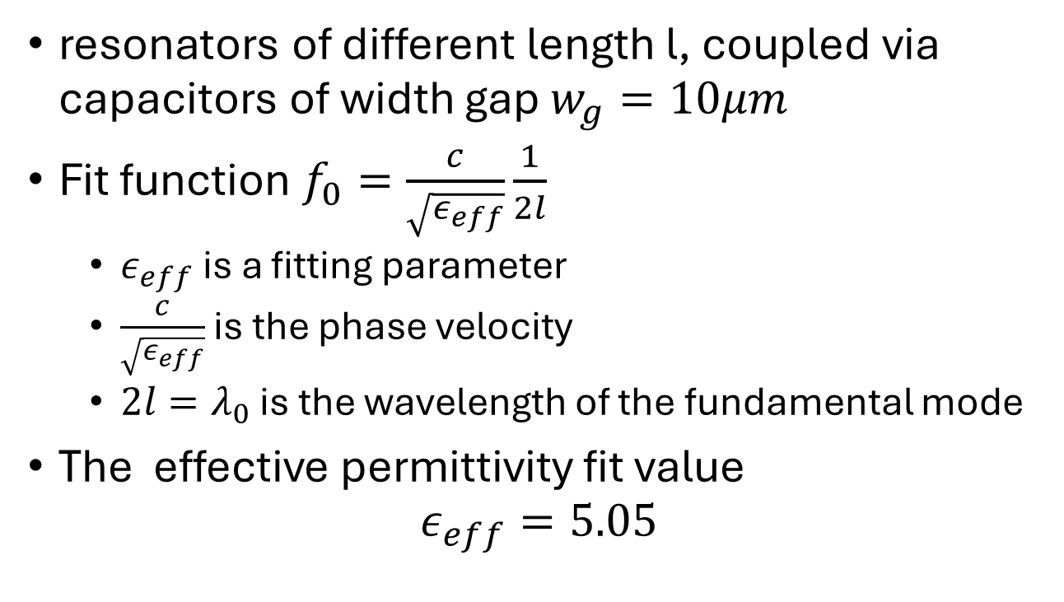
Resonance frequency
resonators of different length l, coupled via capacitors of width gap $w_{g}=10μm$
Fit function $f_{0}=\frac{c}{\sqrt{ε_{eff}}}\frac{1}{2l}$
  $ε_{eff}$ is a fitting parameter
  $\frac{c}{\sqrt{ε_{eff}}}$ is the phase velocity
  $2l=λ_{0}$ is the wavelength of the fundamental mode
The effective permittivity fit value
$ε_{eff}=5.05$

Slide 7
Effective permittivity by TL

Slide 8
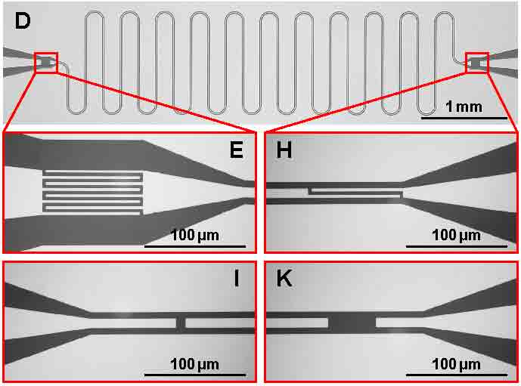
Input/Output Coupling
12 devices with 28.449mm long resonator was coupled using various capacitance.
8 finger capacitors – strong couple
4 gap capacitors – weak couple
All symmetrically coupled

Slide 9
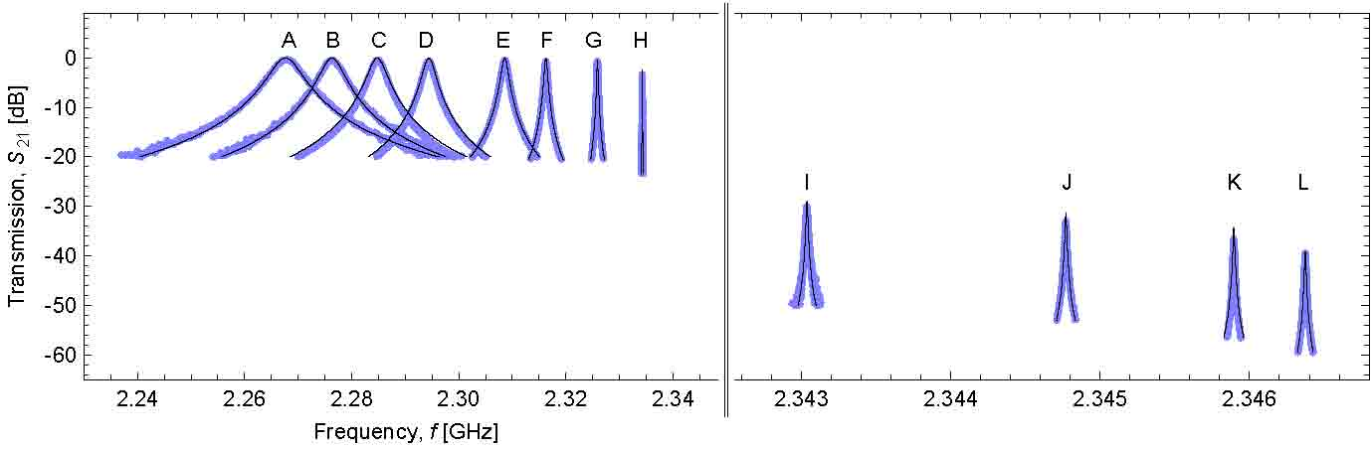
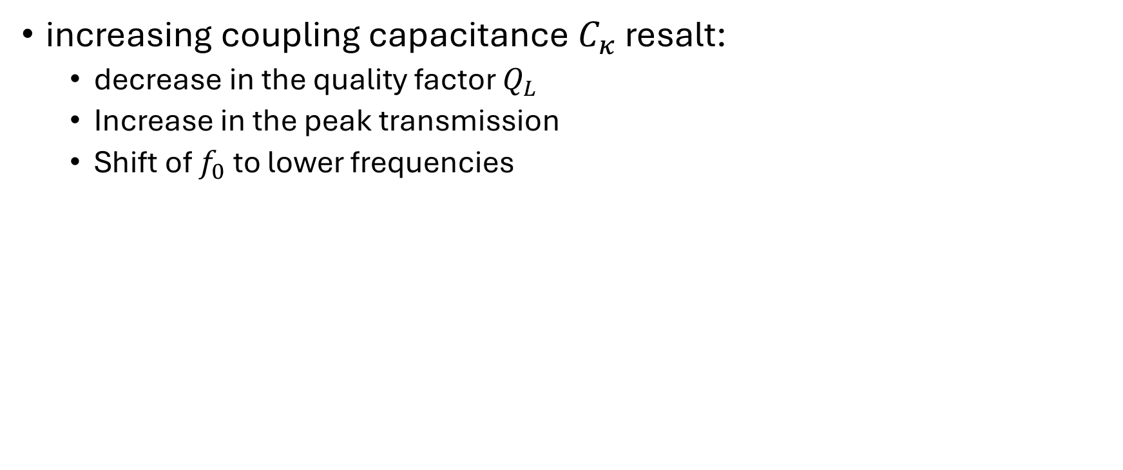
Results
increasing coupling capacitance $C_{κ}$ resalt:
  decrease in the quality factor $Q_{L}$
  Increase in the peak transmission
  Shift of $f_{0}$ to lower frequencies
Gap capacitors
Finger capacitors

Slide 10
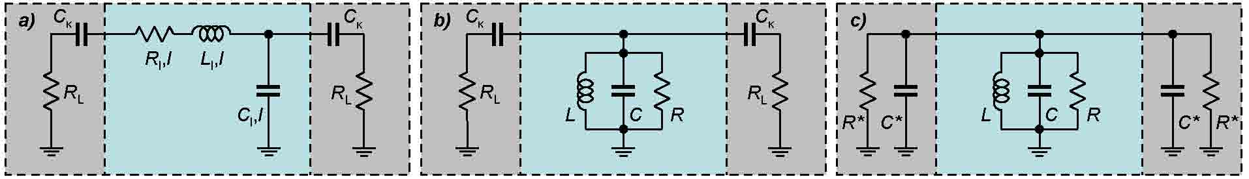
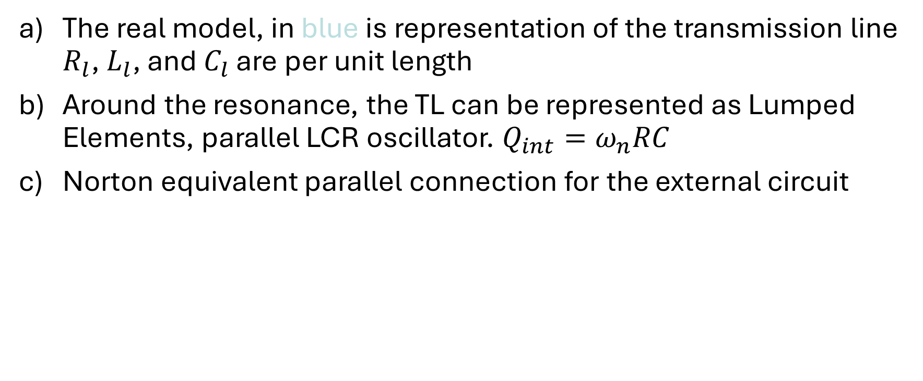
Model Simplification
The real model, in blue is representation of the transmission line $R_{l}$, $L_{l}$, and $C_{l}$ are per unit length
Around the resonance, the TL can be represented as Lumped Elements, parallel LCR oscillator. $Q_{int}=ω_{n}RC$
Norton equivalent parallel connection for the external circuit

Slide 11
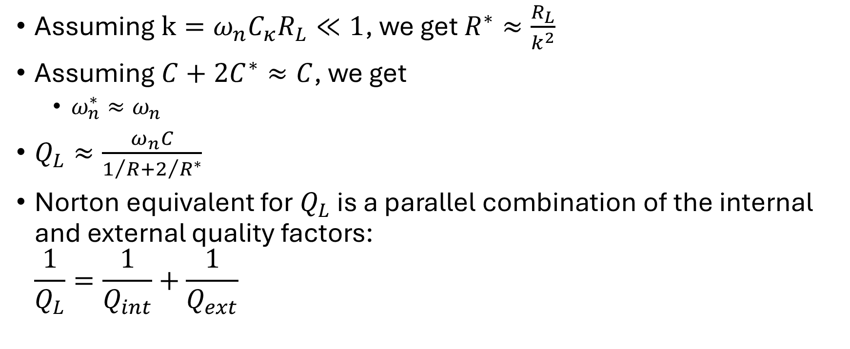
Some approximations
Assuming $k=ω_{n}C_{κ}R_{L}≪1$, we get $R^{∗}≈\frac{R_{L}}{k^{2}}$
Assuming $C+2C^{∗}≈C$, we get
  $ω_{n}^{∗}≈ω_{n}$
$Q_{L}≈\frac{ω_{n}C}{1/R+2/{R^{∗}}}$
Norton equivalent for $Q_{L}$ is a parallel combination of the internal and external quality factors:
$\frac{1}{Q_{L}}=\frac{1}{Q_{int}}+\frac{1}{Q_{ext}}$

